Slide 1
Sentiment Analysis Modelling
Sentiment analysis is a technique that detects the underlying sentiment in a piece of text.
Why sentiment analysis?
• Movie: is this review positive or negative?
• Products: what do people think about the new iPhone?
• Public sentiment: how is consumer confidence? Is despair increasing?
• Politics: what do people think about this candidate or issue?
• Prediction: predict election outcomes or market trends from sentiment

Slide 2
Sentiment Analysis Modelling
Input Sentence
His last movie was Great and Interesting.
But this one’s is dud
Model
Text Preprocessing
Output
Text Cleaning/Noise Removal :
Punctuation Removal
Special character
Numbers
Stopwords removal
Tokenisation
Text Normalization
Vector Generation

Slide 3
In class Assignment : Sentiment Analysis
Assignment is uploaded on portal under Week 2 Day 3 with the name Sentiment Analysis (Inclass Assignment)
I have provided all instructions and reference links ,if anyone has any doubts send me a chat. We will start today’s session at 8:30 pm.

Slide 4
Sentiment Analysis Modelling
Model Preprocessing
Raw Data
Machine Learning Model
Text Preprocessing
Text Vector Generation
Review | Score

Slide 5
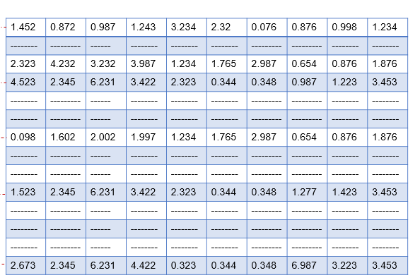
Text Vector Generation
Word Embedding is one such technique where we can represent the text using vectors. The more popular forms of word embeddings are:
The different types of word embedding's can be broadly classified into two categories-
Frequency based Embedding
Model 1 - BoW, which stands for Bag of Words
Model 2 - TF-IDF, which stands for Term Frequency-Inverse Document Frequency
Prediction based Embedding
Deep Learning Techniques - Word2Vec,BERT Transformer
Product
Converting text into n-D vector
Sentiment Analysis
Review :
Great! Just as good as the expensive brands!

Slide 6
Bag of Words
Sentence 1 : The car is driven on the road.
Sentence 2: The truck is driven on the highway.
Words | The | car | is | driven | on | road | Truck | Highway
Sentence #1 | 2 | 1 | 1 | 1 | 1 | 1 | 0 | 0
Sentence #2 | 2 | 0 | 1 | 1 | 1 | 0 | 1 | 1

Slide 7
Bag of Words
“Bag of words- a text is represented as the bag of its words, disregarding grammar and word order but keeping frequency.”
Bag of words
Review | Word #1 | Word #2 | Word #3 | Word #4 | Word #5 | Word #6 | Word #7 | Word #8
Review #1 | 1 | 2 | 1 |  | 3 | 1 | 1
Review #2 |  | 1 |  | 2 | 1 |  | 2
Review #3 | 1 | 1 | 2 |  | 3
Review #4 |  | 1 | 1 |  | 1 | 1 |  | 1
Review #5 | 2 | 1 |  | 1 |  |  | 1 | 1
# of times a word j appears in Review i
In our database, # of Reviews : 16 K
# of words : 12 K
Drawbacks of using a Bag-of-Words (BoW) Model :
High Dimensionality : Size of the vector increases as new words are added to the vocabulary size .
Sparse Matrix : the vectors would also contain many 0s, thereby resulting in a sparse matrix.
Work Importance : Importance of words depends only on the frequency of word .
High importance will be given to frequent repetitive words i.e. review
Low importance will be given to rare occurring words i.e fantastic ,impressive etc
Notes:
Merits : Simplest technique to implement
Demerits : Discard sequence of Words.

Slide 8
Which set of words should have higher weightage ?
Common Words
Rare Words
Foods
Reviews,
Product
Great
Loved
Fantastic

Slide 9
TF (Term Frequency )
TF = Freq of a word in a review /
Total no of words in that review
Sentence 1 : The car is driven on the road. The,car,is,driven,on,road
Sentence 2: The truck is driven on the highway.
Words | The | car | is | driven | on | road | Truck | Highway
Sentence #1 | 0.33 | 0.167 | 0.167 | 0.167 | 0.167 | 0.167 | 0 | 0
Sentence #2 | 0.33 | 0 | 0.167 | 0.167 | 0.167 | 0 | 0.167 | 0.167

Slide 10
IDF (Inverse Document Frequency)
IDF (word) = log ( Total number of Sentences in Dataset / No of sentences that contain word )
Sentence 1 : The car is driven on the road.
Sentence 2: The truck is driven on the highway.
Words | The | car | is | driven | on | road | Truck | Highway
 | =log(2/2) =0 | =log(2/1) =0.3 | 0 | 0 | 0 | 0.3 | 0.3 | 0.3

Slide 11
Sentence 1 : The car is driven on the road.
Sentence 2: The truck is driven on the highway.
Words | The | car | is | driven | on | road | Truck | Highway
Sentence #1 | 0.33 | 0.167 | 0.167 | 0.167 | 0.167 | 0.167 | 0 | 0
Sentence #2 | 0.33 | 0 | 0.167 | 0.167 | 0.167 | 0 | 0.167 | 0.167
TF
Words | The | car | is | driven | on | road | Truck | Highway
 | =log(2/2) =0 | =log(2/1) =0.3 | 0 | 0 | 0 | 0.3 | 0.3 | 0.3
IDF
Weight of word
Words | The | car | is | driven | on | road | Truck | Highway
Sentence #1 | =0.33*0 =0 | =0.167*0.3 =0.05 | 0 | 0 | 0 | 0.05 | 0 | 0
Sentence #2 | 0 | 0 | 0 | 0 | 0 | 0 | 0.05 | 0.05

Slide 12
Term Frequency-Inverse Document Frequency (TF-IDF)
“Term frequency–inverse document frequency, is a numerical statistic that is intended to reflect how important a word is to a document in a collection or corpus.”
Weight of a word = TF x IDF
TF : Local weight
Frequency of a word in single document
IDF : Global weight
Significance of a word in all documents
The Higher the TF * IDF score , more important the word
Higher IDF | Most Unique word. (It is not generic word, it appears only in specific document)
Lower IDF | Most Common word. It's a general word, which appears in most of the document.
Notes:
Demerits : Do not account for Semantics : Women & Ladies
Tiger stripes / zebra stripes

Slide 13
Term Frequency-Inverse Document Frequency (TF-IDF)
“Term frequency–inverse document frequency, is a numerical statistic that is intended to reflect how important a word is to a document in a collection or corpus.”
Weight of a word = TF x IDF
TF : Local weight
Frequency of a word in single document
IDF : Global weight
Significance of a word in all documents
Drawbacks of using a TF-IDF Model :
Model Assumption : Words in corpus are independent.(Order doesn’t matter)
Synonymity; i.e., different terms can be used in the same contexts Example: [car insurance] vs. [auto insurance]
No Order /Semantic : We are retaining no information on the grammar of the sentences nor on the ordering of the words in the text
Notes:
Demerits : Do not account for Semantics : Women & Ladies
Tiger stripes / zebra stripes

